Slide 1
Nvidia Driver installation
https://docs.nvidia.com/cuda/cuda-installation-guide-linux/index.html#pip-wheels
Run the highlighted commands

Slide 2
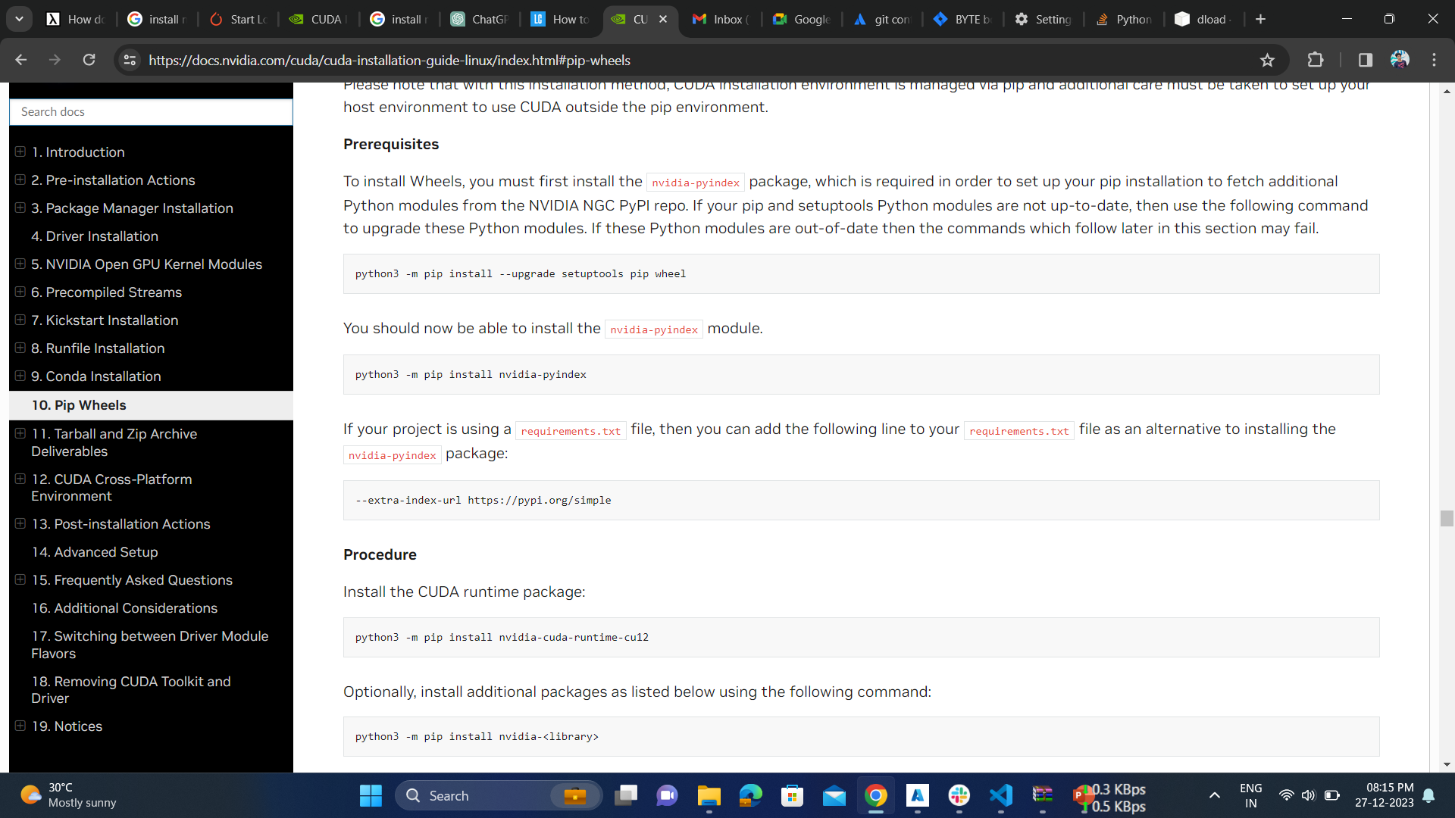




Slide 3
After executing above commands
Sudo apt-get install ubuntu-drivers
Sudo ubuntu-drivers install nvidia:535
Sudo reboot

